Slide 1

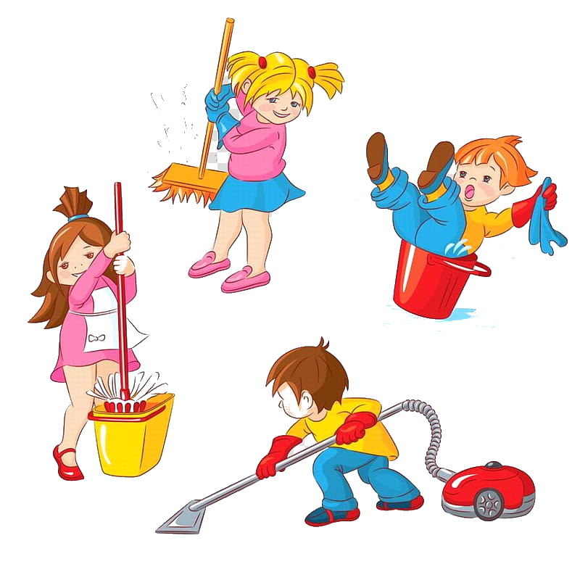
Unit 1: Clean up!
Grade 3
Lesson Four: Phonics

Slide 2

Song: There are ten in the bed

Slide 3

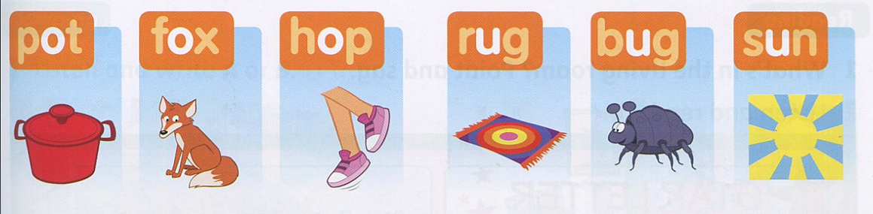
Listen and point

Slide 4

Listen and repeat

Slide 5
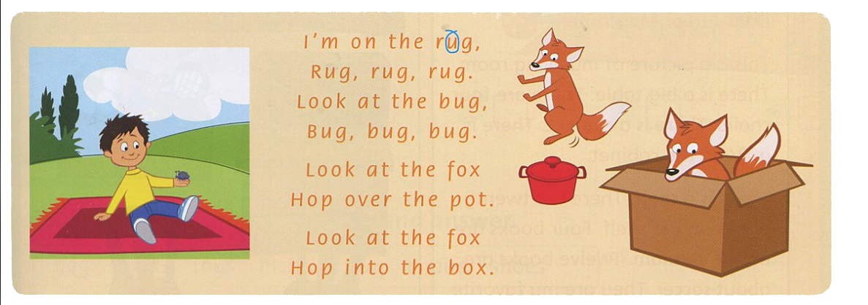
Listen, point and chant

Slide 6

Task:
Read the chant and circle the word with O and U.
Answer

Slide 7
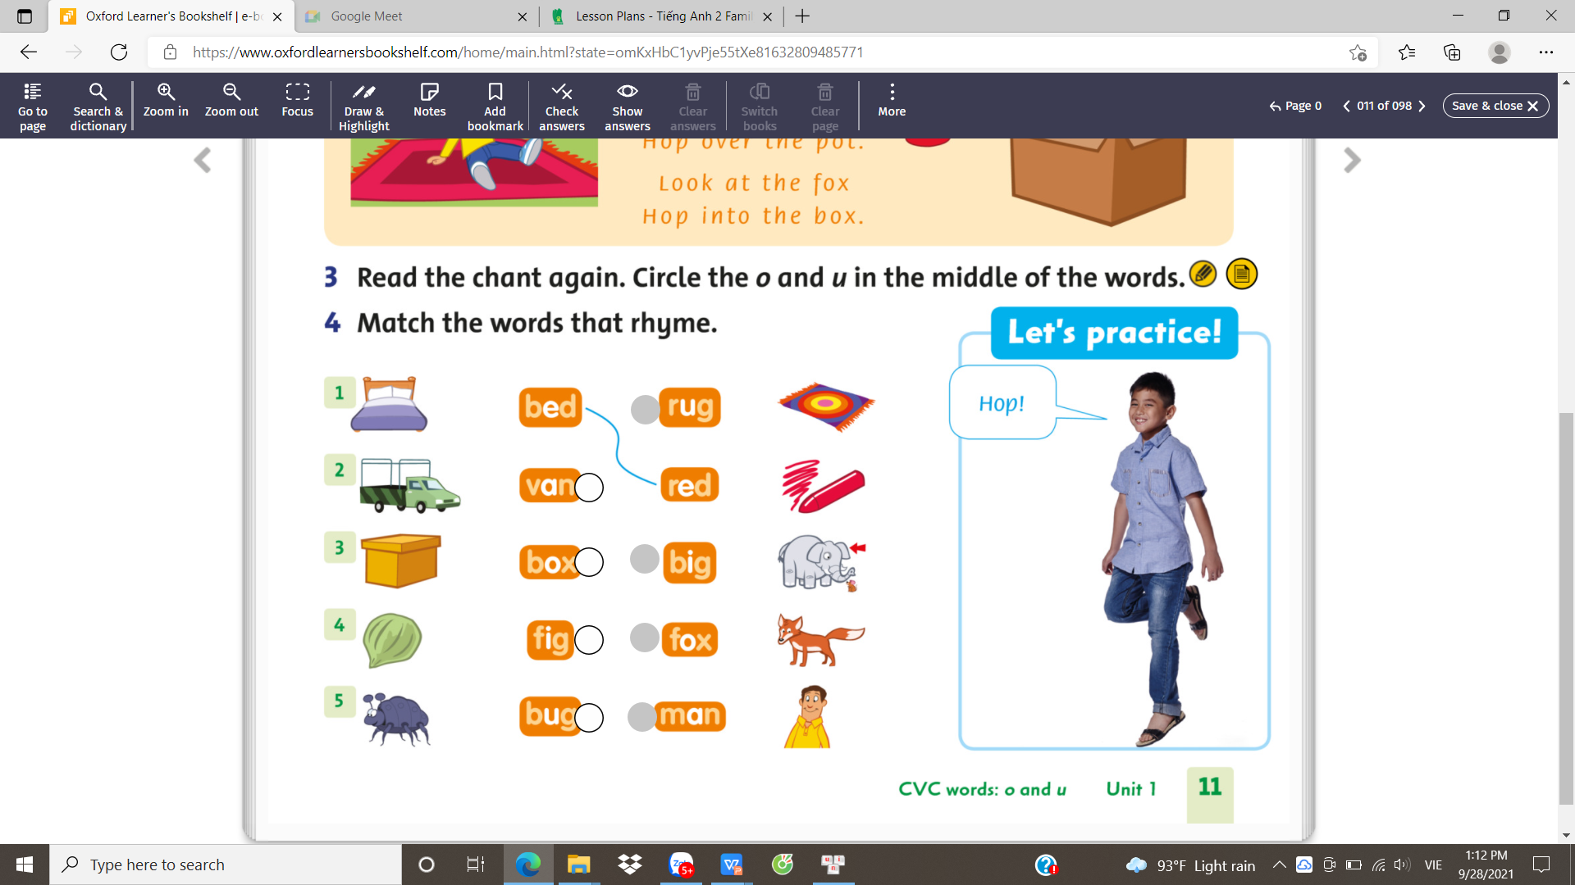

Slide 8
Unit 1: Clean up!
Grade 3
Lesson Five: Reading

Slide 9
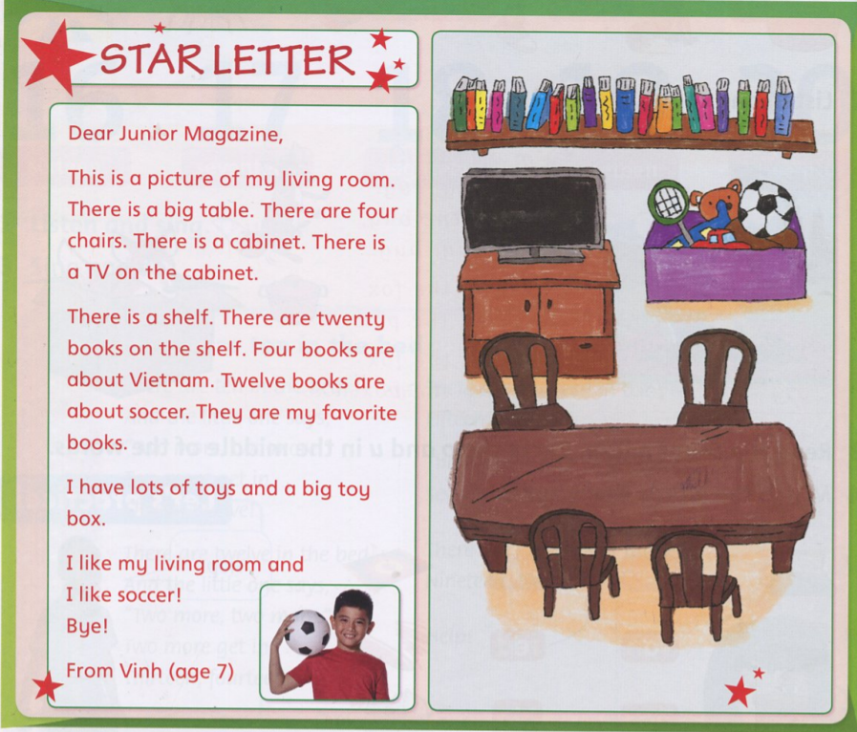
Tasks:
Look at the paintwork of the living room.
Point and tell what are in the living room.

Slide 10
Tasks:
Read and circle new words if there is any.

Slide 11

Listen and point along

Slide 12
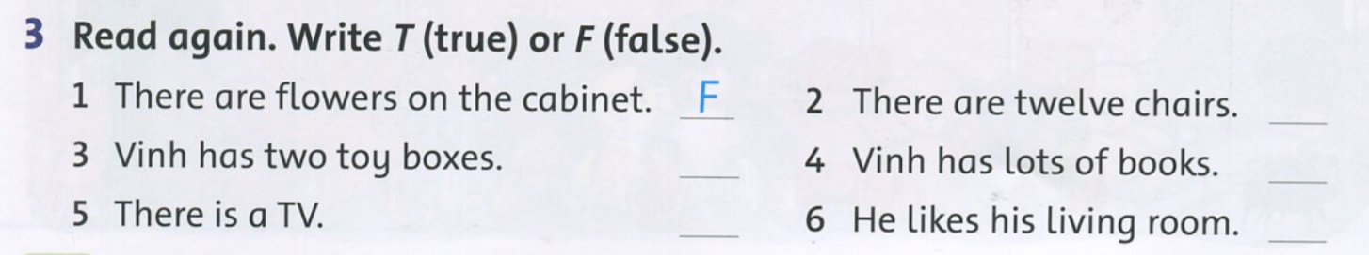
Tasks:
Read again the passage.
Write T or F.
F
F
T
T
T
Answer

Slide 13
Unit 1: Clean up!
Grade 3
Lesson Six: Listening

Slide 14
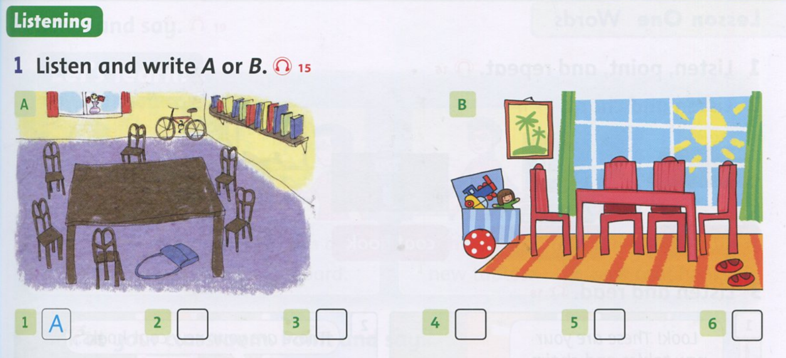
Answer
Tasks:
Listen to the audio
Write A or B
B
B
A
B
A

Slide 15

Tasks: Work in pairs
Look at the pictures again.
Ask and answer
Ex: Where is the bag?
-> It's under the table.

Slide 16
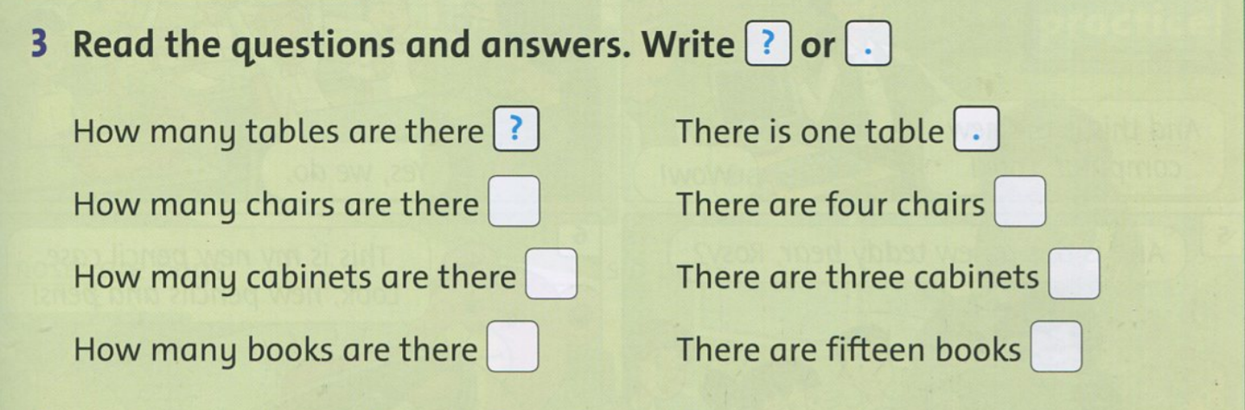
Tasks:
Using questions in exercise 3 to ask and answer about your living room.
Work in pairs: Read the questions and answers. Write "?" Or ".“.

Slide 17

What to do?
Finish the exercises in your workbook!
p.11-13

Slide 18


Goodbye~!

